Slide 1

Affine Loop Optimization using Modulo Unrolling in CHAPEL
Aroon Sharma, Joshua Koehler, Rajeev Barua
LTS POC: Michael Ferguson

Slide 2
Overall Goal
Improve the runtime of certain types of parallel computers
  In particular, message passing computers
Approach
  Start with an explicitly parallel program
  Compile using our method to minimize communication cost between nodes of the parallel computer
Advantage: Faster scientific and data processing computation

Slide 3
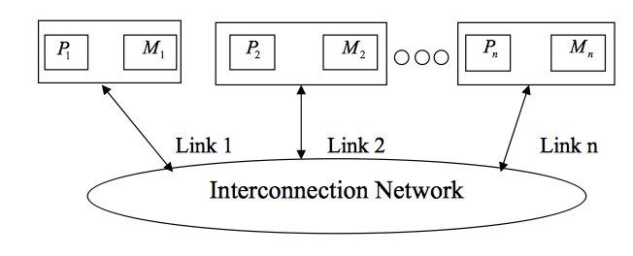
Message Passing Architectures
Communicate data among a set of processors with separate address spaces using messages
  Remote Direct Memory Access (RDMA)
High Performance Computing Systems
100-100,000 compute nodes
Complicates compilation

Slide 4
PGAS Languages
Partitioned Global Address Space (PGAS)
Provides illusion of a shared memory system on top of a distributed memory system
Allows the programmer to reason about locality without dealing with low-level data movement
Example - CHAPEL

Slide 5

CHAPEL
PGAS language developed by Cray Inc.
Programmers express parallelism explicitly
Features to improve programmer productivity
Targets large scale and desktop systems
Opportunities for performance optimizations!

Slide 6
Our Work’s Contribution
We present an optimization for parallel loops with affine array accesses in CHAPEL.
The optimization uses a technique known as modulo unrolling to aggregate messages and improve the runtime performance of loops for distributed memory systems using message passing.

Slide 7
Outline
Introduction and Motivation
Previous Work
Modulo Unrolling
Optimized Cyclic and Block Cyclic Dists
Results
What about Block?

Slide 8
Affine Array Accesses
Most common type of array access in scientific codes
  A[i], A[j], A[3], A[i+1], A[i + j], A[2i + 3j]
  A[i, j], A[3i, 5j]
Array accesses are affine if the access on each dimension is a linear expression of the loop indices
  E.g. A[ai + bj + c] for a 2D loop nest
  Where a, b, and c are constant integers

Slide 9
Example Parallel Loop in CHAPEL
forall i in 1..10 do
A[i] = B[i+2];
What happens when the data is distributed?
1
2
3
4
5
6
7
8
9
10
11
12
13
14
15
A:
B:
Notes:
Copying elements from B to A, Shown here in the picture, copying into A an element of B that is two elements over

Slide 10
Data Distributions in CHAPEL
Describe how data is allocated across locales for a given program
  A locale is a unit of a distributed computer (processor and memory)
Users can distribute data with CHAPEL’s standard modules or create their own distributions
Distributions considered in this study
  Cyclic
  Block
  Block Cyclic
Notes:
We don’t override the user’s chosen data distribution. This distribution could have been chosen for reasons unknown to the compiler. What we do want to do is improve the compilation for whatever distribution the user did choose.

Slide 11
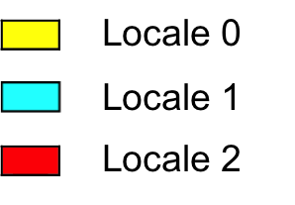
Data Distributions in CHAPEL - Block
use BlockDist;
var domain = {1..15};
var distribution = domain dmapped Block(boundingBox=domain);
var A: [distribution] int;
// A is now distributed in the following fashion
1
2
3
4
5
6
7
8
9
10
11
12
13
14
15
A:

Slide 12
Data Distributions in CHAPEL - Cyclic
use CyclicDist;
var domain = {1..15};
var distribution = domain dmapped Cyclic(startIdx=domain.low);
var A: [distribution] int;
// A is now distributed in the following fashion
1
2
3
4
5
6
7
8
9
10
11
12
13
14
15
A:

Slide 13
Data Distributions in CHAPEL – Block Cyclic
use BlockCycDist;
var domain = {1..15};
var distribution = dom dmapped BlockCyclic(blocksize=3);
var A: [distribution] int;
// A is now distributed in the following fashion
1
2
3
4
5
6
7
8
9
10
11
12
13
14
15
A:
*similar code is used to distributed multi-dimensional arrays

Slide 14
Distributed Parallel Loop in CHAPEL
forall i in 1..10 do
A[i] = B[i+2];
1
2
3
4
5
6
7
8
9
10
11
12
13
14
15
A:
B:
4 Messages
  Locale 1 → Locale 0 containing B[6]
  Locale 1 → Locale 0 containing B[7]
  Locale 2 → Locale 1 containing B[11]
  Locale 2 → Locale 1 containing B[12]

Slide 15
Data Communication in CHAPEL can be Improved
Locality check at each loop iteration
  Is B[i+2] local or remote?
Each message contains only 1 element
We could have aggregated messages
  Using GASNET strided get/put in CHAPEL
  Locale 1 → Locale 0 containing B[6], B[7]
  Locale 2 → Locale 1 containing B[11], B[12]
Growing problem
  Runtime increases for larger problems and more complex data distributions

Slide 16
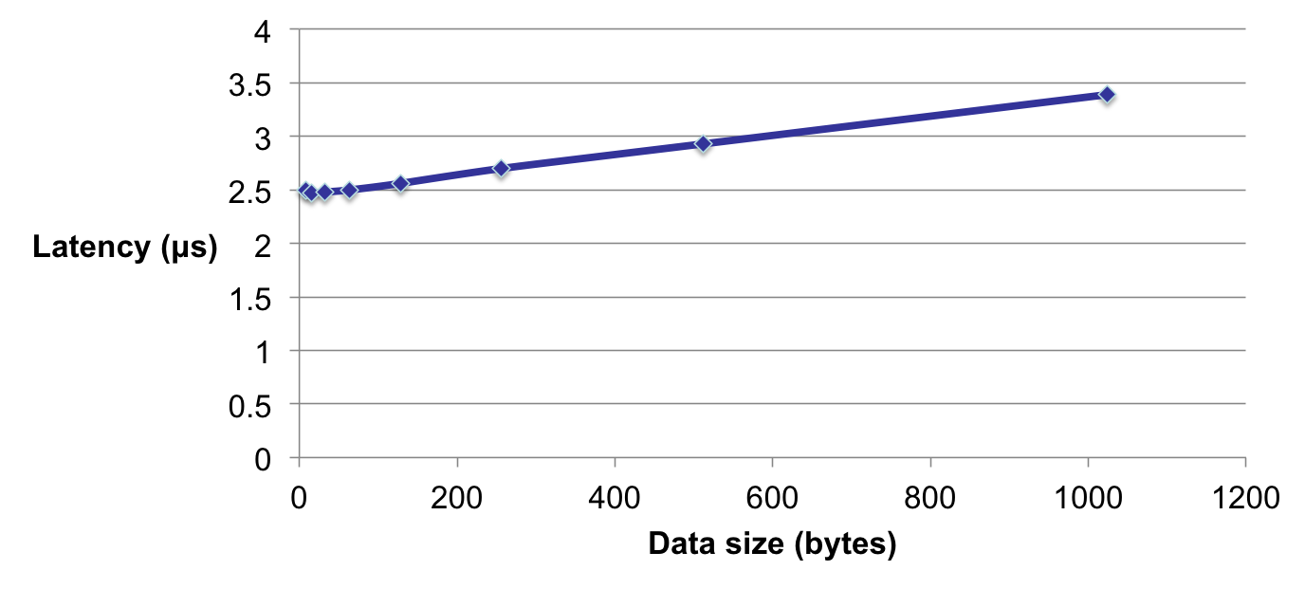
Data Transfer Round Trip Time for Infiniband
Notes:
Much more efficient to communicate big messages than small messages. Bigger messages only take slightly longer so much more efficient to communicate bigger messages

Slide 17
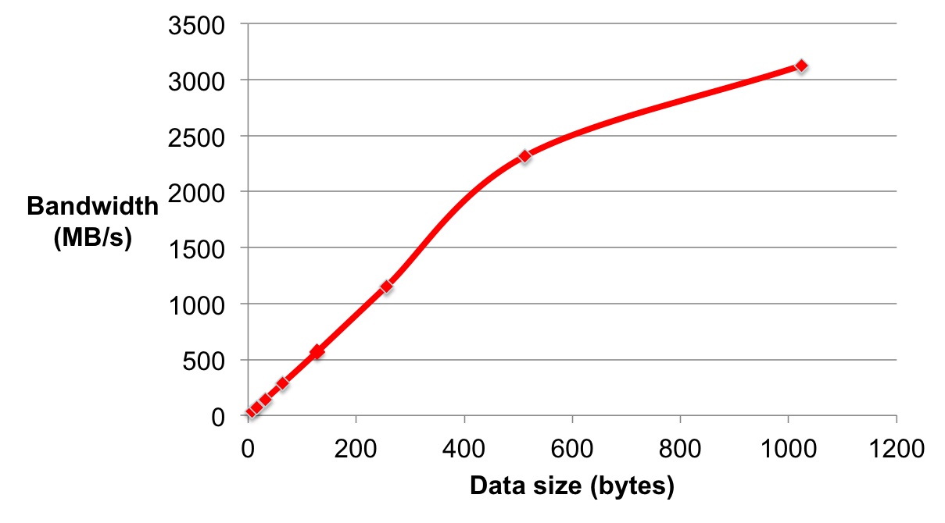
Bandwidth measurements for Infiniband
Notes:
Y axis now bandwidth. Same trend. We want to be to the right on the graph.

Slide 18
How to improve this?
Use knowledge about how data is distributed and loop access patterns to aggregate messages and reduce runtime of affine parallel loops
We are not trying to
  Apply automatic parallelization to CHAPEL
  Come up with a new data distribution
  Bias or override the programmer to a particular distribution
We are trying to
  Improve CHAPEL’s existing data distributions to perform better than their current implementation

Slide 19
Outline
Introduction and Motivation
Previous Work
Modulo Unrolling
Optimized Cyclic and Block Cyclic Dists
Results
What about Block?

Slide 20
Traditional Method – See Ramanujam1991
Loop fission, fusion, interchange, peeling, etc.
Software pipelining, scheduling, etc.
Pros
  + discovering parallelism
  + increasing the granularity of parallelism
  + improving cache performance

Slide 21
Traditional Method – See Ramanujam1991
Cons
  Code generation for message passing is complex and limiting
  Needs
    Footprint calculations which can be modeled with matrix calculations
    Intersections of footprint with data distributions → result in irregular shaped which cannot be modeled with matrix transformations
    Splitting footprints into portions per locale also complex and can’t be modeled with matrix transformations
  Real compilers limit aggregation to the simplest of stencil codes

Slide 22
Polyhedral Method – See Benabderrahmane2010
Boundaries traced for each array use of a loop and intersected with the data distribution
Applied to block distributions
Pros
  + Has mathematical framework to express parallelism and find sequences of transformations in one step
  + Good at automatic parallelization and improves parallelism, granularity of parallelism, and cache locality
Cons
  Core polyhedral method does not compute information for message passing code generation
  Uses ad hoc add-ons for message passing
Notes:
Add ons are much like the traditional method and have the same disadvantages as them

Slide 23
PGAS Methods – See Chen2005
Redundancy elimination, split-phase communication, communication coalescing
Pros
  + eliminates the need for cross thread analysis
  + targets fine-grained communication in UPC compiler
Cons
  No locality analysis that statically determines whether an access is shared or remote

Slide 24
Outline
Introduction and Motivation
Previous Work
Modulo Unrolling
Optimized Cyclic and Block Cyclic Dists
Results
What about Block?

Slide 25
Modulo Unrolling – See Barua1999
Method to statically disambiguate array accesses at compile time
Unroll the loop by factor = number of locales
Each array access will reside on a single locale across loop iterations
Applicable for Cyclic and Block Cyclic
Notes:
Modulo unrolling developed by Barua for tiled architectures such as MIT Raw computer. We’ve realized that we can apply this to message passing code generation for the first time. We’ve made significant modifications to make it apply.

Slide 26
Modulo Unrolling Example
for i in 1..99 {
A[i] = A[i] + B[i+1];
}
Each iteration of the loop accesses data on a different locale
1
2
3
4
5
6
7
8
9
10
11
12
13
14
15
16
A:
…
B:
…
Locale 3

Slide 27
Modulo Unrolling Example
for i in 1..99 by 4 {
A[i] = A[i] + B[i+1];
A[i+1] = A[i+1] + B[i+2];
A[i+2] = A[i+2] + B[i+3];
A[i+3] = A[i+3] + B[i+4];
}
Loop unrolled by a factor of 4 automatically by the compiler
1
2
3
4
5
6
7
8
9
10
11
12
13
14
15
16
A:
…
B:
…
Locale 3

Slide 28
Modulo Unrolling Example
for i in 1..99 by 4 {
A[i] = A[i] + B[i+1];
A[i+1] = A[i+1] + B[i+2];
A[i+2] = A[i+2] + B[i+3];
A[i+3] = A[i+3] + B[i+4];
}
Locale 0
Locale 1
Locale 2
Locale 3
A[1], A[5], A[9], …
A[2], A[6], A[10], …
A[3], A[7], A[11], …
A[4], A[8], A[12], …
B[1], B[5], B[9], …
B[2], B[6], B[10], …
B[3], B[7], B[11], …
B[4], B[8], B[12], …
1
2
3
4
5
6
7
8
9
10
11
12
13
14
15
16
A:
…
B:
…
Locale 3
How do we apply this concept in Chapel?
Notes:
Every reference always accesses the same locale even as i keeps changing. Happens for all array accesses. Because we have this information, we know where the messages are coming from and we can aggregate messages from the same node.

Slide 29
Outline
Introduction and Motivation
Previous Work
Modulo Unrolling
Optimized Cyclic and Block Cyclic Dists
Results
What about Block?

Slide 30
CHAPEL Zippered Iteration
Can be used with parallel for loops
Leader iterator
  Creates tasks to implement parallelism and assigns iterations to tasks
Follower iterator
  Carries out work specified by leader (yielding elements) usually serially

Slide 31
CHAPEL Zippered Iteration
Follower iterators of A, B, and C will be
responsible for doing work for each task
forall (a, b, c) in zip(A, B, C) {
code…
}
Because it is first, A’s leader iterator
will divide up the work among available tasks
*See Chamberlain2011 for more detail on leader/follower semantics

Slide 32
CHAPEL Zippered Iteration
It turns out any parallel forall loop with affine array accesses can be written using zippered iteration over array slices
forall i in 1..10 {
A[i] = B[i+2];
}
forall (a,b) in zip(A[1..10], B[3..12]){
a = b;
}
Zippered iteration
Implement modulo unrolling and message aggregation within the leader and follower iterators of the Block Cyclic and Cyclic distributions!

Slide 33
Modulo Unrolling in CHAPEL Cyclic Distribution
forall (a,b) in zip(A[1..10], B[3..12]) do
a = b;
1
2
3
4
5
6
7
8
9
10
11
12
13
14
15
16
A:
…
B:
…
Locale 3
*if yielded elements are written to during the loop, a similar bulk put message is required to update remote portions of array
Leader iterator allocates locale 0 with iterations 1, 5, 9, …
Follower iterator of B recognizes that its work 3, 7, 11, … is remote on locale 2
Elements of B’s chunk of work brought to locale 0 via 1 bulk get message to a local buffer
Elements of local buffer are now yielded back to loop header
Locale 0

Slide 34
Modulo Unrolling in CHAPEL Block Cyclic Distribution
forall (a,b) in zip(A[1..10], B[3..12]) do
a = b;
1
2
3
4
5
6
7
8
9
10
11
12
13
14
15
16
A:
…
B:
…
Locale 3
Aggregation now occurs with elements in the same location within each block
Both leader and follower needed to be modified
Locale 0

Slide 35
Outline
Introduction and Motivation
Previous Work
Modulo Unrolling
Optimized Cyclic and Block Cyclic Dists
Results
What about Block?

Slide 36
Benchmarks
Name | Dimension | Description | Input (elements)
2mm | 2D | Matrix mulitplication | 16 x 16
cholesky | 2D | Cholesky decomposition | 128 x 128
jacobi-2d | 2D | Jacobi relaxation | 400 x 400
jacobi-1d | 1D | Jacobi relaxation | 10000
stencil9 | 2D | 9-point stencil calculation | 400 x 400
folding | 1D | Sum consecutive elements of array using strided access pattern | N = 50400, 10 iterations
pascal | 1D | Computes rows of pascal’s triangle | N1 = 10000, N2 = 10003
covariance | 2D | Covariance calculation | 128 x 128
correlation | 2D | Correlation | 64 x 64
* Data collected on 10 node Golgatha cluster at LTS

Slide 37
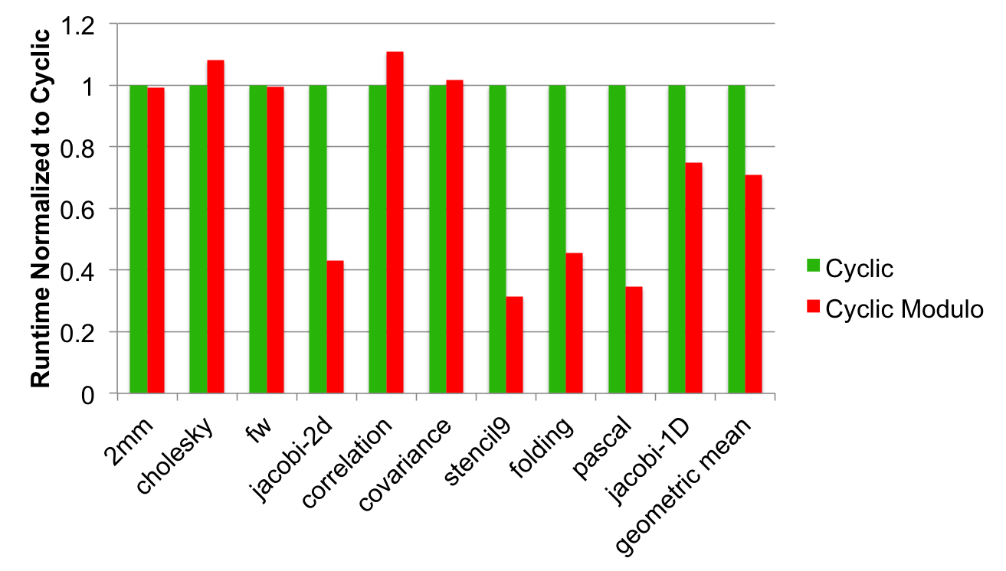
Cyclic vs. Cyclic Modulo Normalized Runtime
On average 30% decrease in runtime

Slide 38
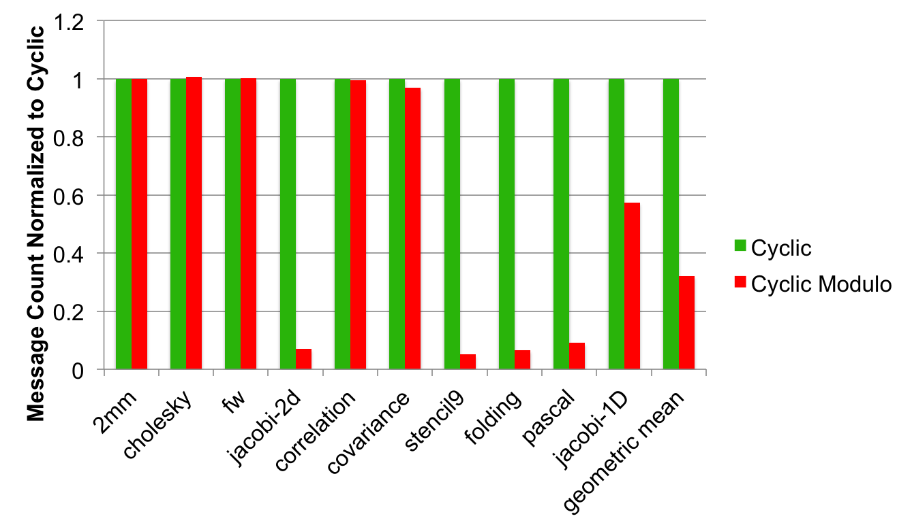
Cyclic vs. Cyclic Modulo Normalized Message Counts
On average, 68% fewer messages

Slide 39
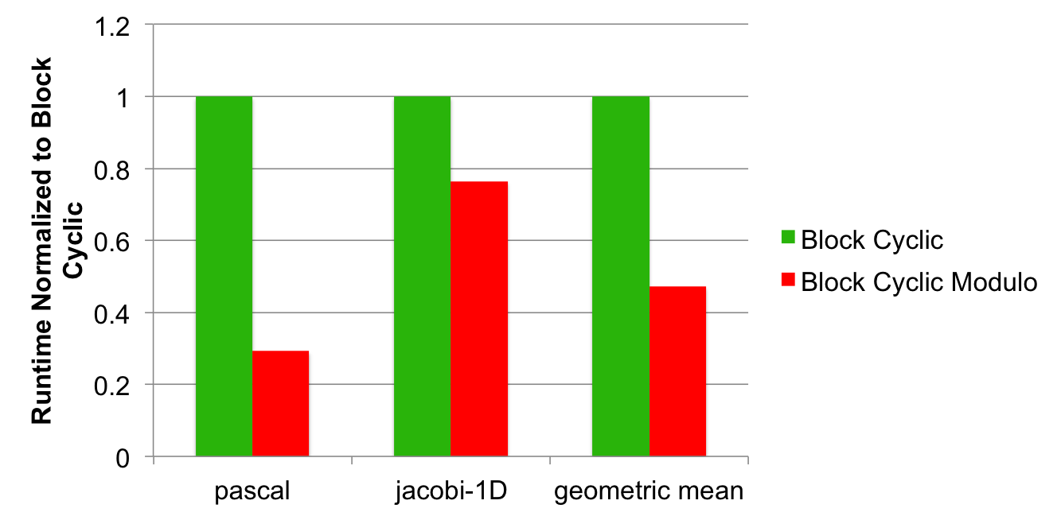
Block Cyclic vs. Block Cyclic Modulo Normalized Runtime
On average 52% decrease in runtime
Notes:
We only have data for two benchmarks because this work is still in progress. The underlying trend is the same.

Slide 40
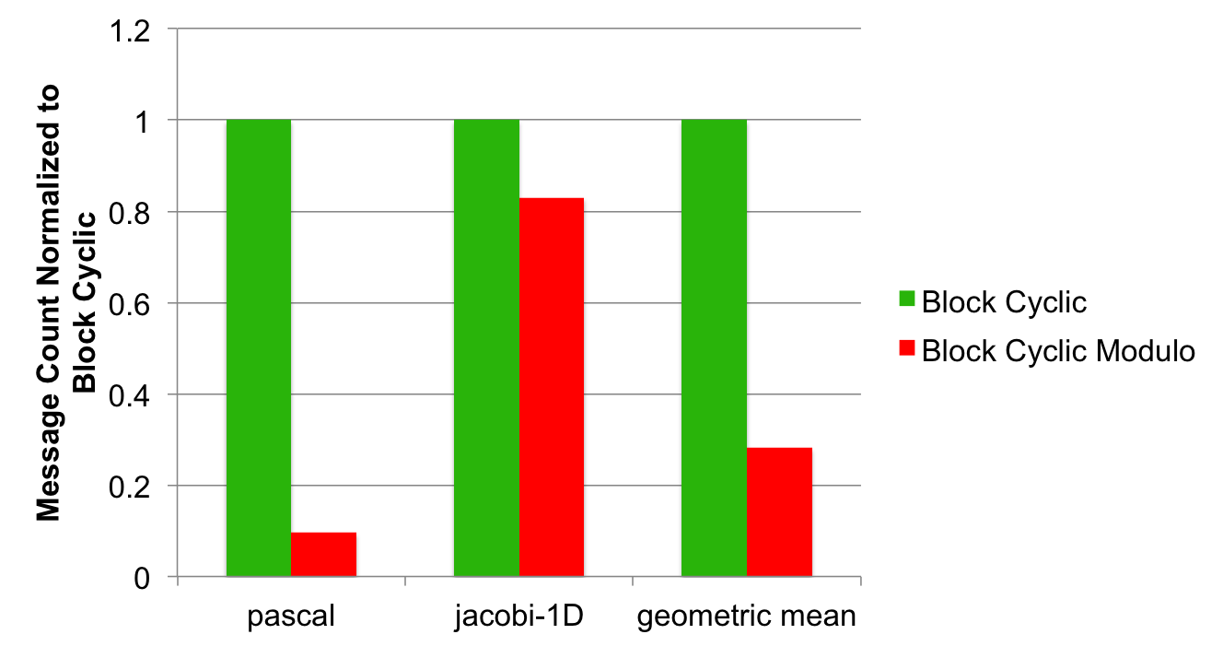
Block Cyclic vs. Block Cyclic Modulo Normalized Message Count
On average 72% fewer messages

Slide 41
Outline
Introduction and Motivation
Previous Work
Modulo Unrolling
Optimized Cyclic and Block Cyclic Dists
Results
What about Block?

Slide 42
What about Block?
Our method does not help the Block distribution
  Reason: Needs cyclic pattern
For Block, we use the traditional method

Slide 43
Conclusion
We’ve presented optimized Cyclic and Block Cyclic distributions in CHAPEL that perform modulo unrolling
Our results for Cyclic Modulo and Block Cyclic Modulo show improvements in runtime and message counts for affine programs

Slide 44
References
[1] Barua, R., & Lee, W. (1999). Maps: A Compiler-Managed Memory System for Raw Machine. Proceedings of the 26th International Symposium on Computer Architecture, (pp. 4-15).
[2] User-Defined Parallel Zippered Iterators in Chapel, Chamberlain, Choi, Deitz, Navarro; October 2011
[3] M.-W. Benabderrahmane, L.-N. Pouchet, A. Cohen, and C. Bastoul. The polyhedral model is more widely applicable than you think. In ETAPS International Conference on Compiler Construction (CC’2010), pages 283–303, Mar. 2010.

Slide 45
References
[4] Compile-time techniques for data distribution in distributed memory machines. J Ramanujam, P Sadayappan - Parallel and Distributed Systems, IEEE Transactions on, 1991
[5] Chen, Wei-Yu, Costin Iancu, and Katherine Yelick. "Communication optimizations for fine-grained UPC applications." Parallel Architectures and Compilation Techniques, 2005. PACT 2005. 14th International Conference on. IEEE, 2005.

Slide 46
Questions?

Slide 47
Backup Slides

Slide 48
CHAPEL Zippered Iteration
Iterators
  Chapel construct similar to a function
  return or “yield” multiple values to the callsite
  Can be used in loops
iter fib(n: int) {
var current = 0,
next = 1;
for i in 1..n {
yield current;
current += next;
current <=> next;
}
}
for f in fib(5) {
writeln(f);
}
Being used in a loop
f is the next yielded value of fib after each iteration
Output: 0, 1, 1, 2, 3

Slide 49
CHAPEL Zippered Iteration
Zippered Iteration
  Multiple iterators of the same size are traversed simultaneously
  Corresponding iterations processed together
for (i, f) in zip(1..5, fib(5)) {
writeln(“Fibonacci ”, i, “ = ”, f);
}
Output
Fibonacci 1 = 0
Fibonacci 2 = 1
Fibonacci 3 = 1
Fibonacci 4 = 2
Fibonacci 5 = 3

Slide 50
What about Block?
2D Jacobi Example – Transformed Pseudocode
For each block in parallel
forall (k1,k2) in {0..1, 0..1} {
if A[2 + 3k1, 2 + 3k2].locale.id == $ then on $ {
buf_north = get(A[2+3k1..4+3k1, 2+3k2-1..4+3k2-1]);
buf_south = get(A[2+3k1..4+3k1, 2+3k2+1..4+3k2+1]);
buf_east = get(A[2+3k1-1..4+3k1-1, 2+3k2..4+3k2]);
buf_west = get(A[2+3k1+1..4+3k1+1, 2+3k2..4+3k2]);
LB_i = 2+3k1;
LB_j = 2+3k2;
forall(i, j) in {2+3k1..4+3k1, 2+3k2..4+3k2} {
A_{new}[i,j] = (buf_north[i-LB_i, j-LB_j] + buf_south[i-LB_i, j-LB_j] +
buf_east[i-LB_i, j-LB_j] + buf_west[i-LB_i, j-LB_j])/4.0;
}
}
Bring in remote
portions of array
footprint locally
Do the computation using local buffers

Slide 51
What about Block?
It seems that data distributed using Block naturally results in fewer messages for many benchmarks
Makes sense because many benchmarks in scientific computing access nearest neighbor elements
Nearest neighbor elements are more likely to reside on the same locale
Could we still do better and aggregate messages?

Slide 52
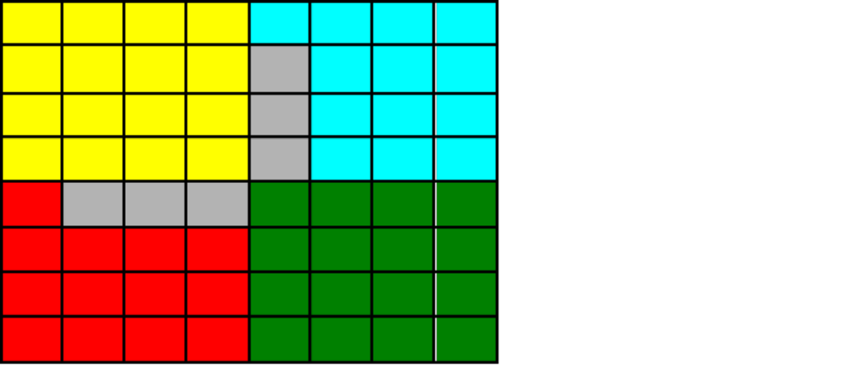
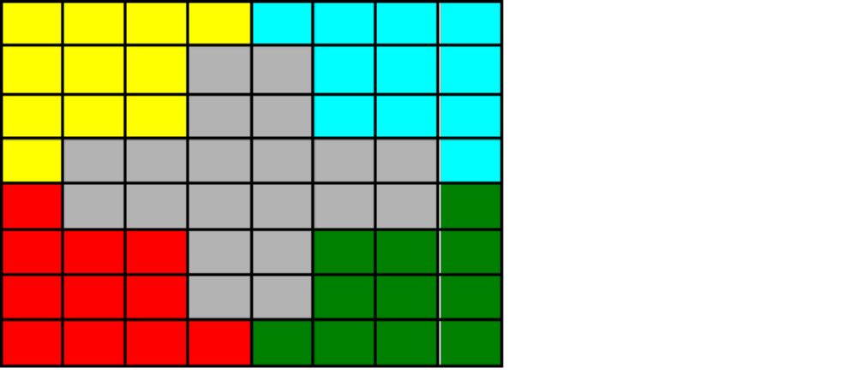
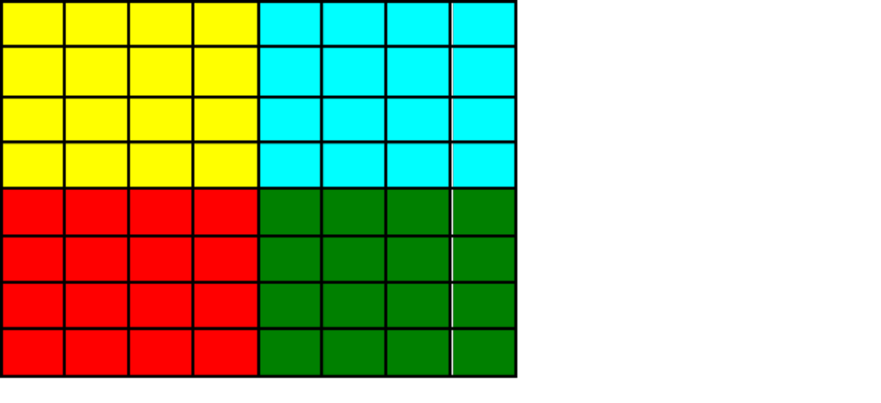
What about Block?
2D Jacobi Example
2 remote blocks per locale → 2 messages
8 messages with aggregation
24 messages without
Messages without aggregation grows as problem size grows
i
1
2
3
4
5
6
7
8
1
2
j
3
4
5
Locale 3
6
7
8
A[i, j-1]
A[i-1, j]
A[i, j]
A[i+1, j]
forall (i,j) in {2..7, 2..7} {
A_{new}[i,j] = (A[i+1, j] + A[i-1, j] + A[i, j+1] + A[i, j-1])/4.0;
}
A[i, j+1]

Slide 53
LTS Golgatha Cluster Hardware Specs
10 hardware nodes
Infiniband communication layer between nodes
2 sockets per node
Intel Xeon X5760 per socket
  2.93GHz
  6 cores (12 hardware threads w/ 2 way hyperthreading)
  24GB RAM per processor

